Slide 1
Bankruptcy Prediction
Kaushal Kashyap
Student(Learnbay)

Slide 2
Preface
Understand the Objectives & Get familiar with data
Import Necessary Libraries
Load the Dataset (_BANKRUPTCY_PREDICTION.CSV)
Descriptive Analysis( shape, column variable, ..etc)
EDA ( Visualisation, null, skewness, duplicate, heatmap…etc)
Splitting of data
Scaling, balance the unbalance data, transform, create the ML Model
Evaluation and choose the good fit model, plot the feature importance..

Slide 3
Understand the Objectives & Get familiar with data
Objective- This exercise aims to build a model, using historical data that will determine the prediction of bankruptcy.
Data Consist of Bank/Organization/company information which contains its all factors what happened or happening inside it.
Data Structure- it contained continuous data with target variable “Bankrupt”(Boolean).
No_of_columns – 95 Nos
No_of_Rows – 6819 Nos

Slide 4
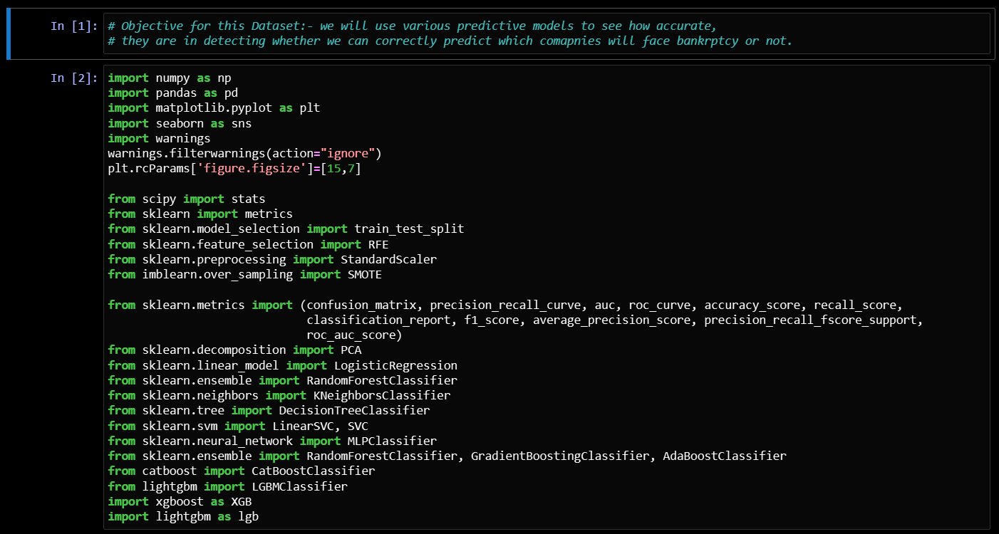
Import Necessary Libraries

Slide 5
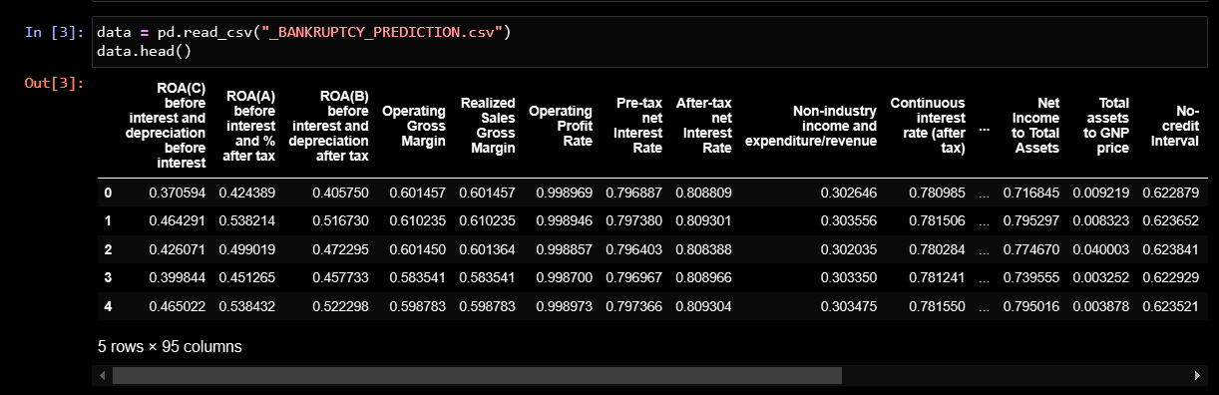
Load the Dataset

Slide 6
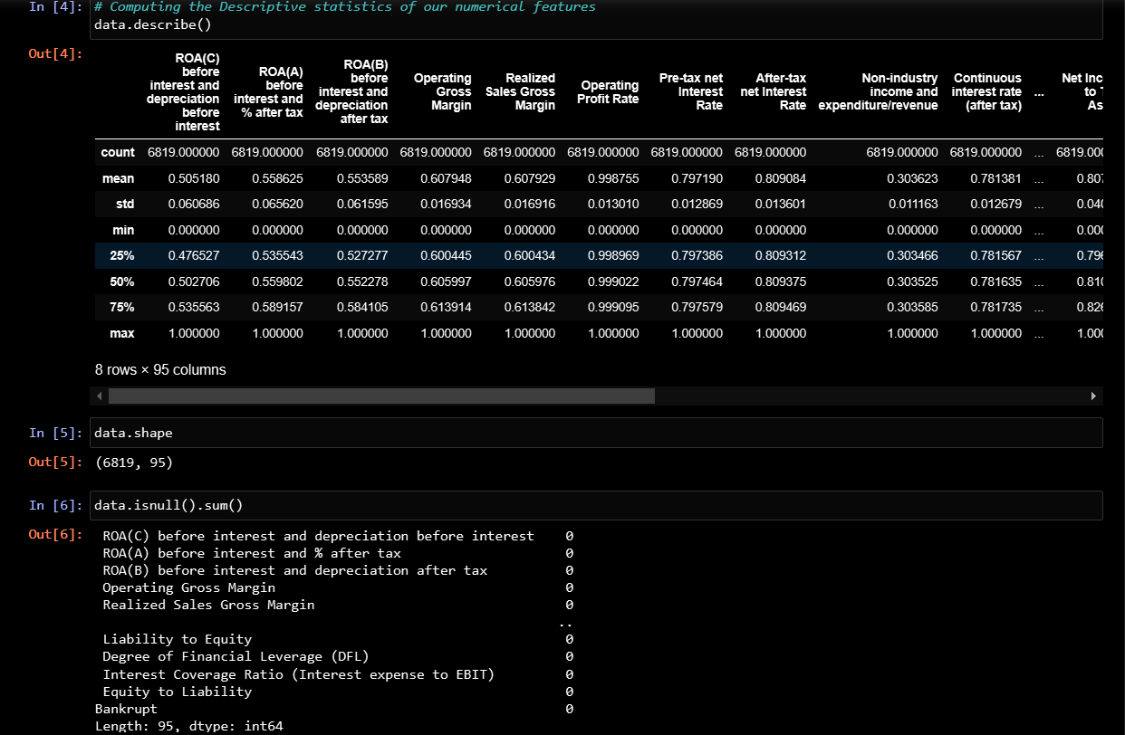
Descriptive Analysis( shape, column variable, ..etc)

Slide 7
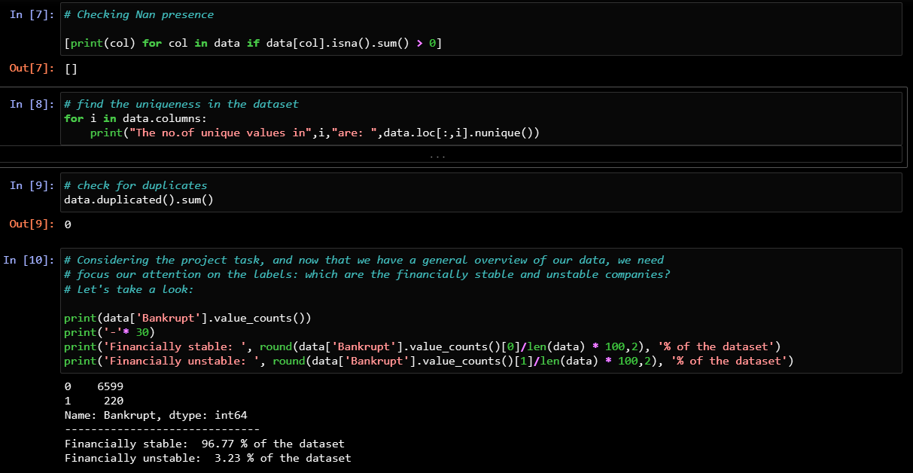
EDA ( Visualisation, null, skewness, duplicate, heatmap…etc)

Slide 8
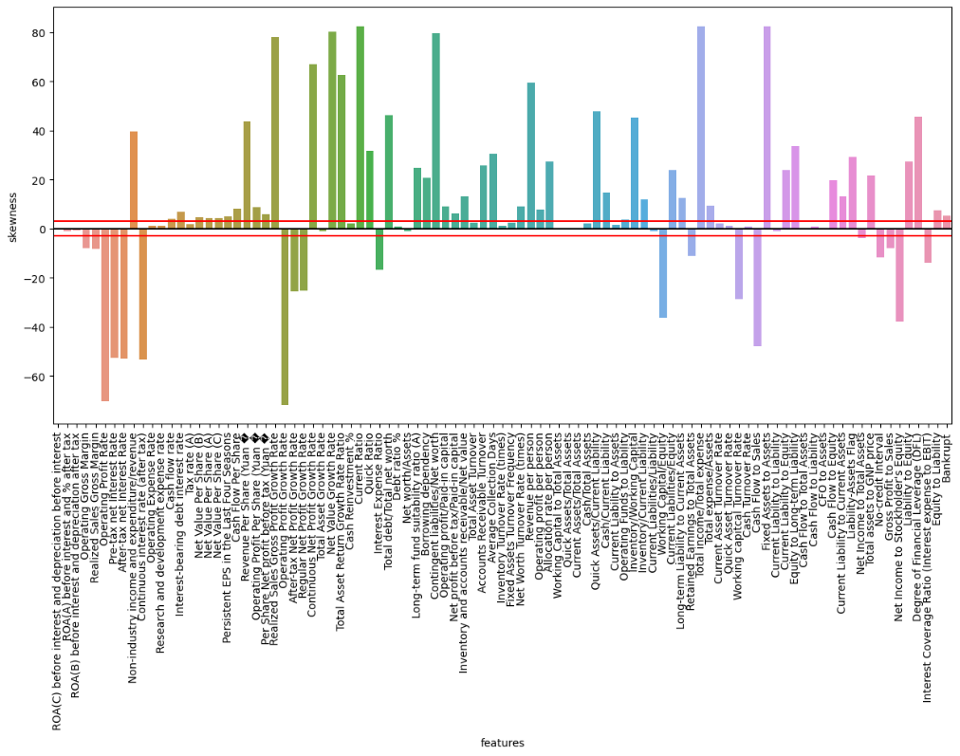
Skewness

Slide 9
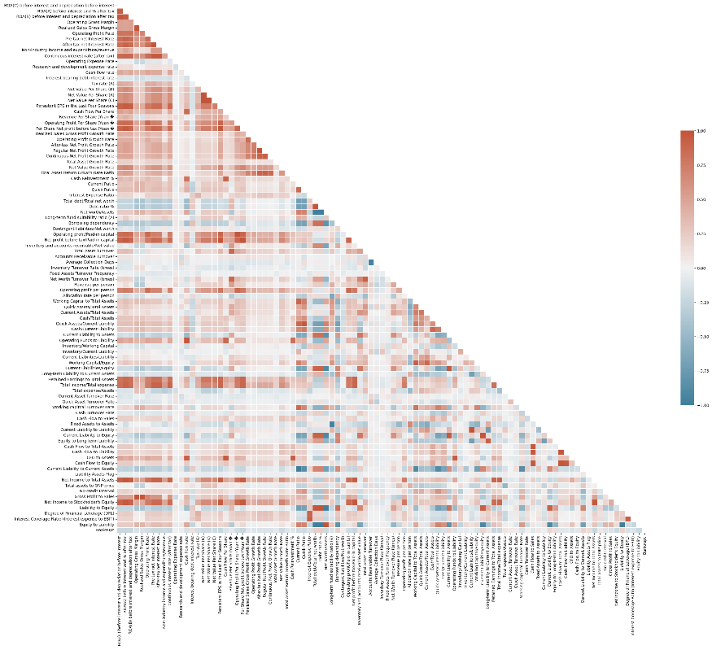
Heatmap

Slide 10
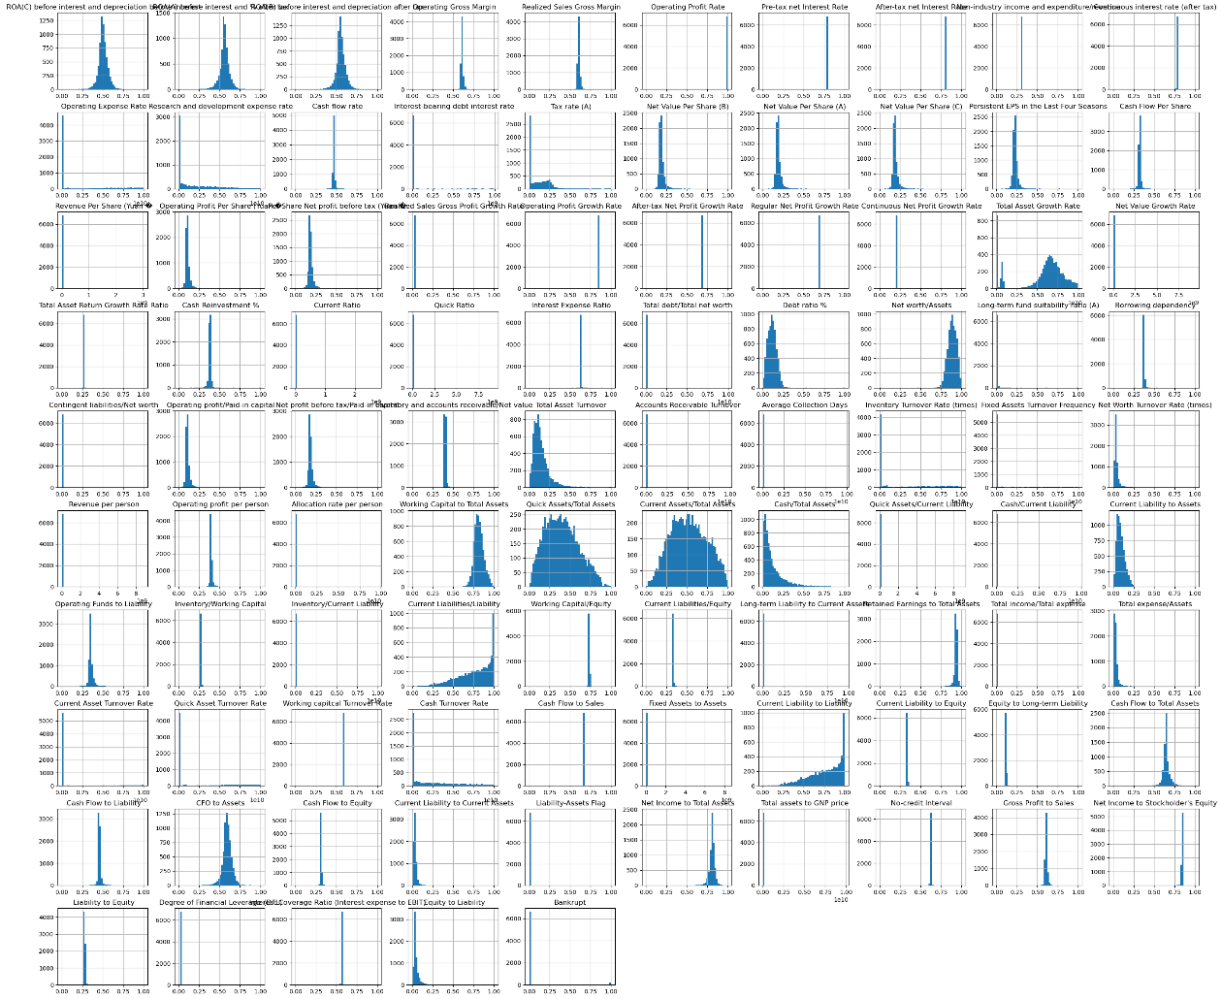
Histogram

Slide 11
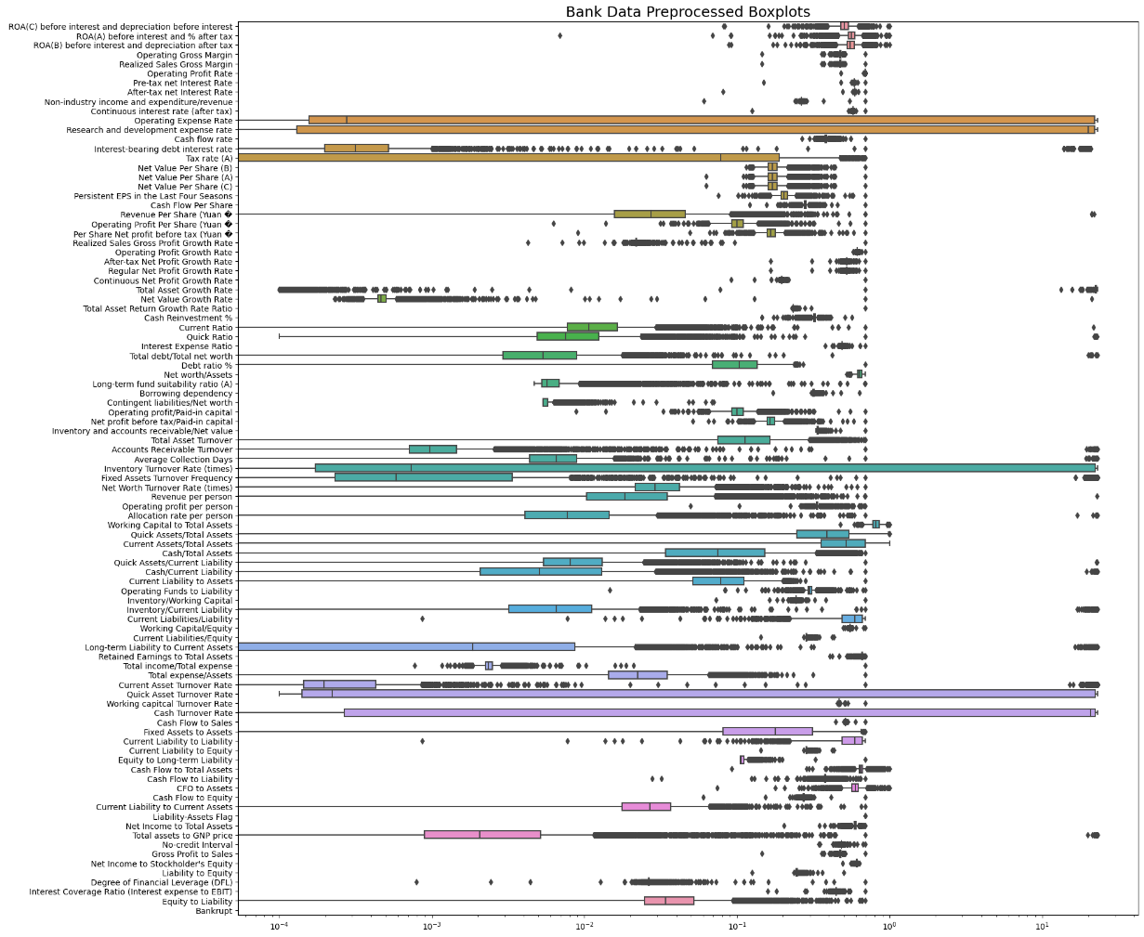
Boxplot

Slide 12
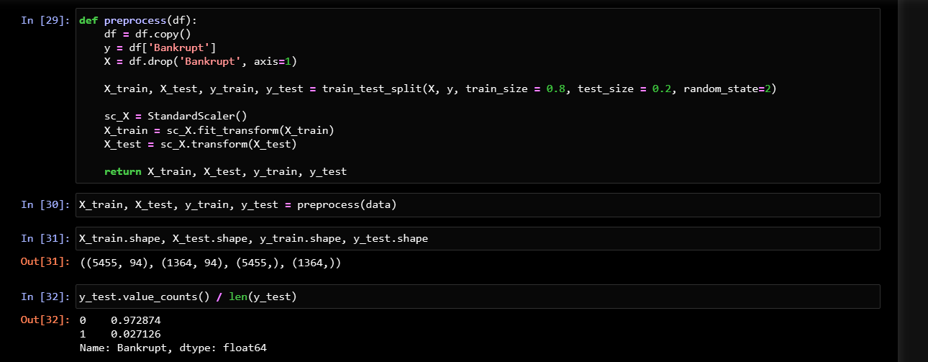
Splitting of data

Slide 13
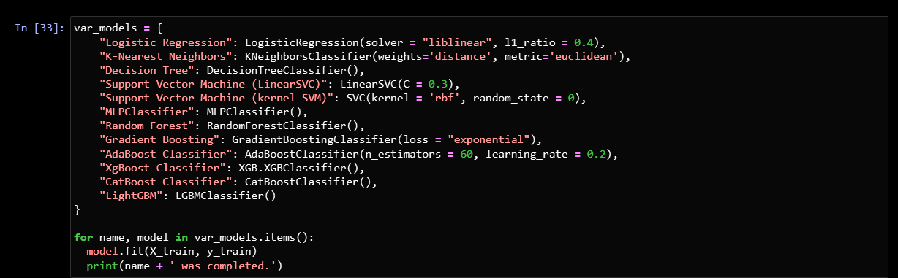
Scaling, balance the unbalance data, transform, create the ML Model
Scaling was done at the time Splitting in function preprocess().

Slide 14
Evaluation and choose the good fit model, plot the feature importance..
We follow the process where model performs on original (Scaled) data and then it again perform on imbalance maintained data using (smote).
As per the Comparison, we evaluate with GridSearch CV to improve the performance and its accuracy but found that No such big change after using this too..
Then we look for Feature importance where which variable have what contribution to get Company/Organisation Bankrupt.

Slide 15
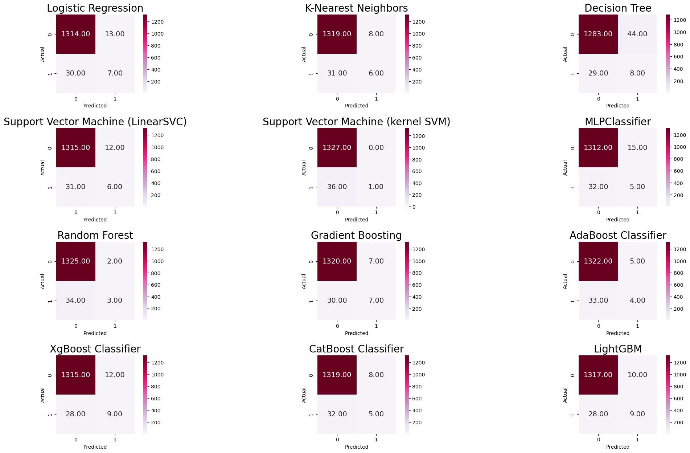
Result of Model’s performance (without imbalance managed)

Slide 16
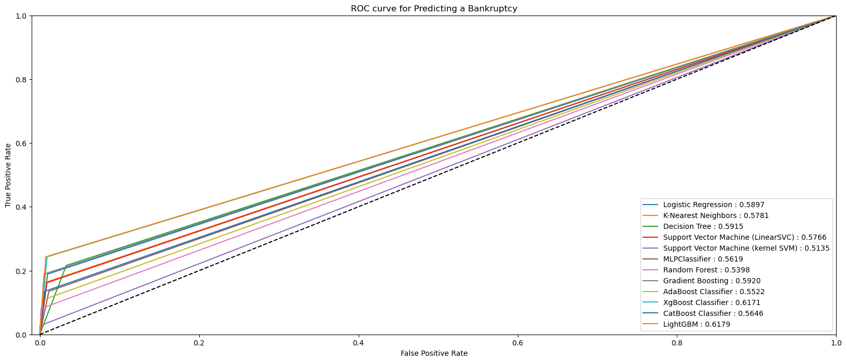
ROC AUC Curve Display (without imbalance managed)

Slide 17
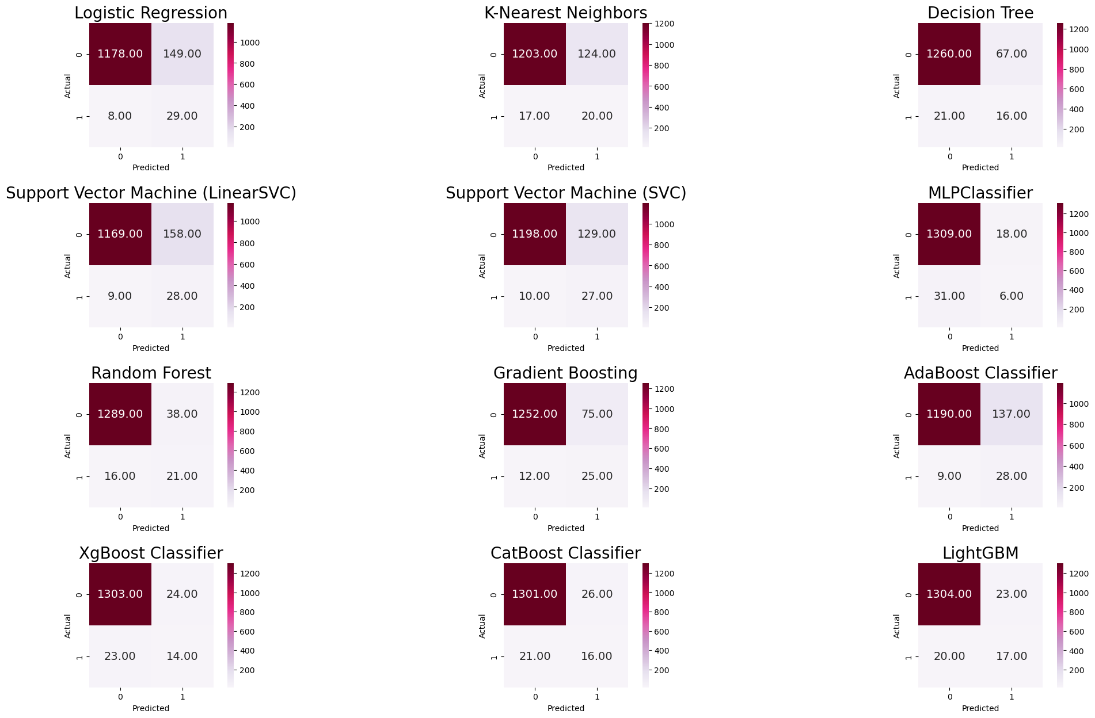
Result of Model’s performance (with imbalance managed)

Slide 18
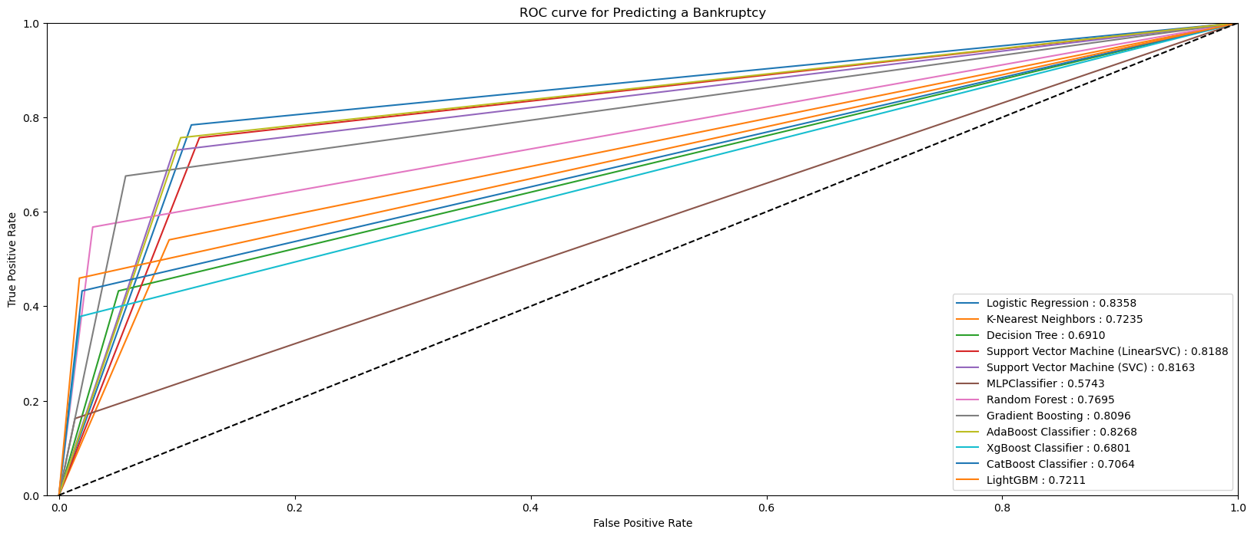
ROC AUC Curve Display (with imbalance managed)

Slide 19
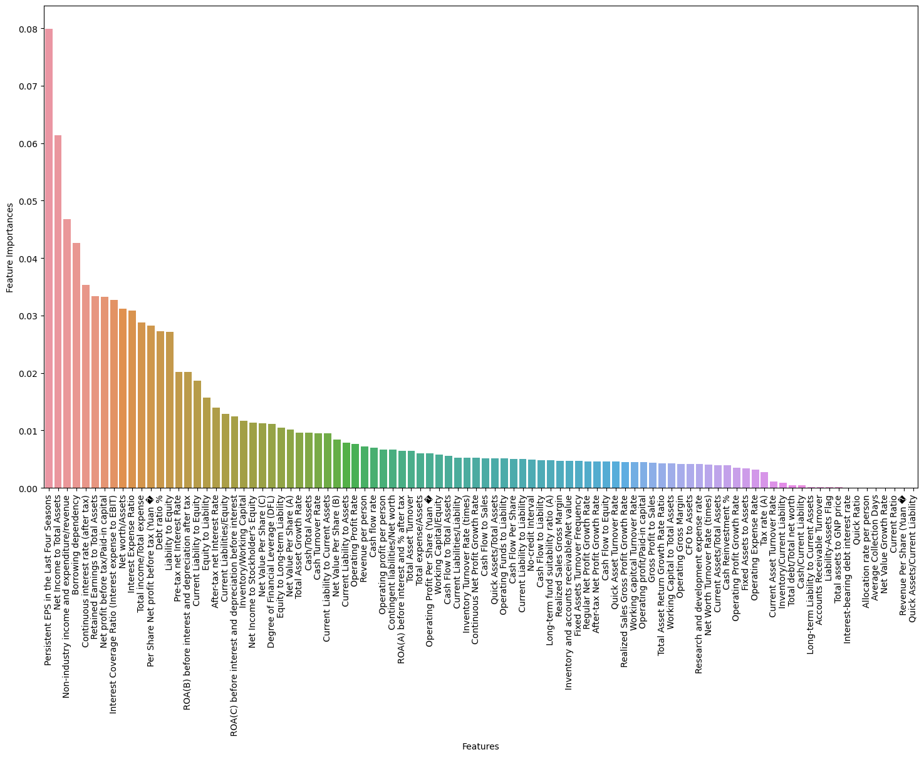
Feature Importance
Factors which have some importance in bankruptcy of Company/Organisation

Slide 20


